Slide 1
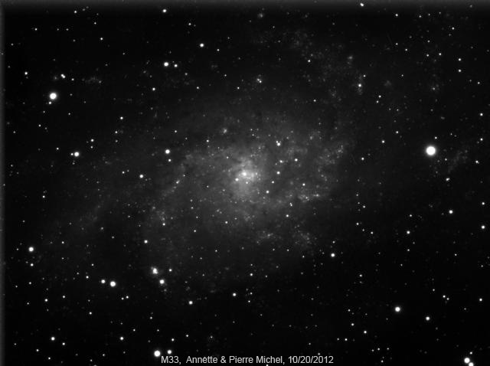

Slide 2
“What’s up”
A presentation of “what’s up” in the night sky

Slide 3
This Month’s Sky: September2012
Our Solar System Tonight
This Month’s Astro Events
Target List
Gee Whiz Question of the Month
CE Observing Challenge

Slide 4
Our Solar System Tonight
 | Rises | Sets
Sun | 7:32 A.M. | 5:29 P.M.
Moon | 9:29 A.M. | 8:26 P.M.
Mercury | 6:07 A.M. | 4:21 P.M.
Venus | 5:34 A.M. | 3:57 P.M.
Mars | 9:33 A.M. | 7:30 P.M.
Jupiter | 4:25 P.M. | 6:32 A.M.
Saturn | 3:53 A.M. | 2:25 P.M
Uranus | 1:08 P.M. | 1:22 A.M
Neptune | 11:37 P.M. | 10:37 A.M.
Pluto | 8:26 A.M. | 6:40 P.M

Slide 5
This Month’s Astro Events
Mercury at elongation
Mercury, Venus, Saturn spectacle
See a Dwarf Planet (other than Pluto)
Jupiter Dominates
Heads up for December

Slide 6
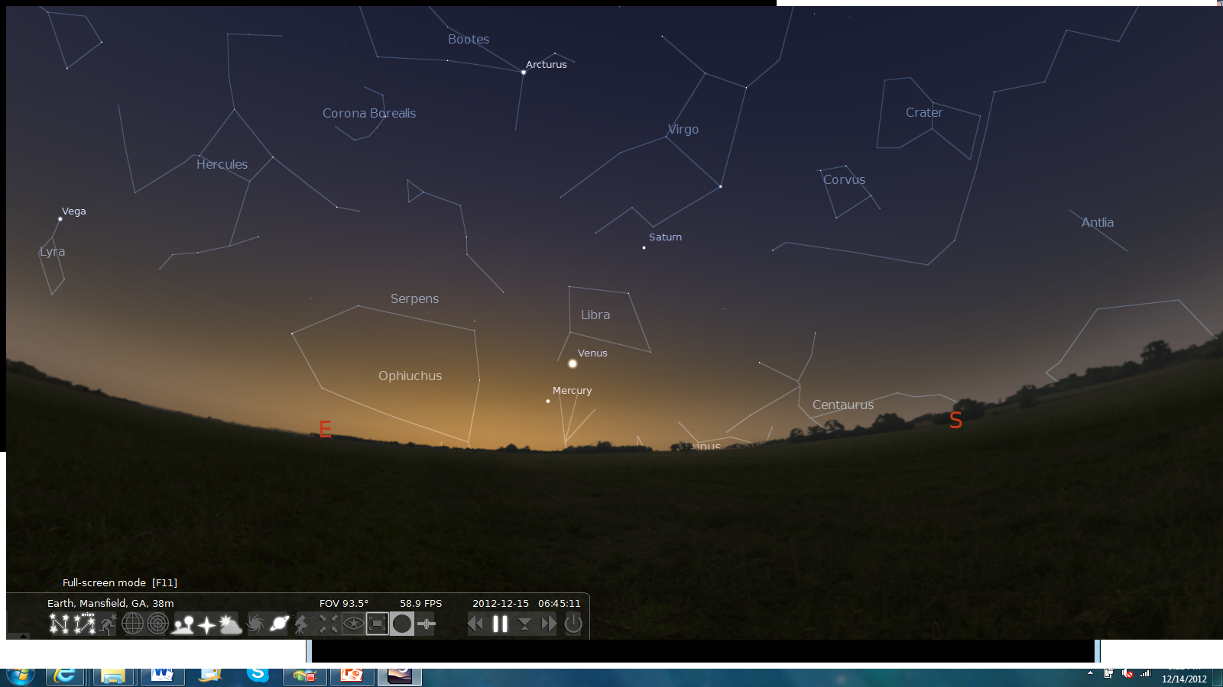
Mercury Follows Venus & Saturn

Slide 7
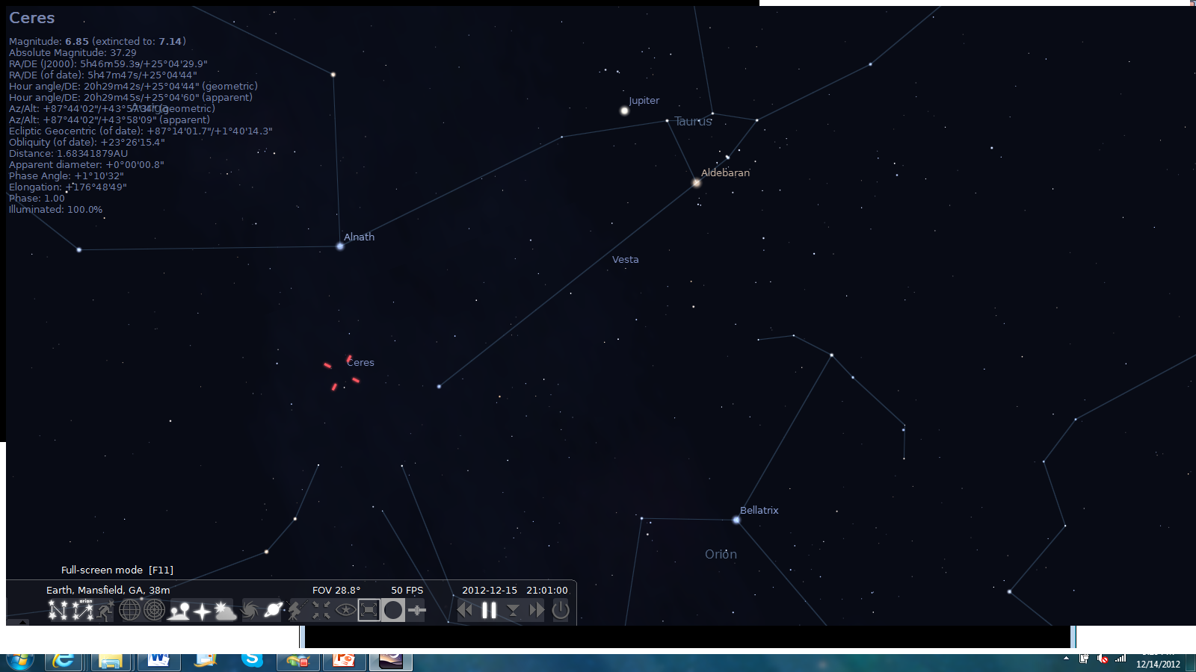
Dwarf Planets
Ceres/Vesta

Slide 8
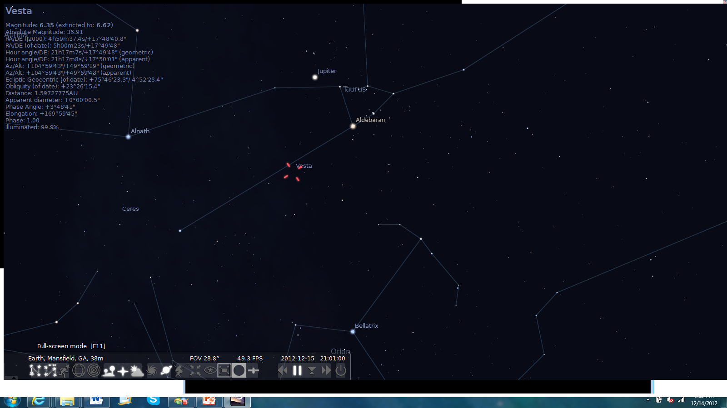
Dwarf Plantes
Ceres/Vesta

Slide 9
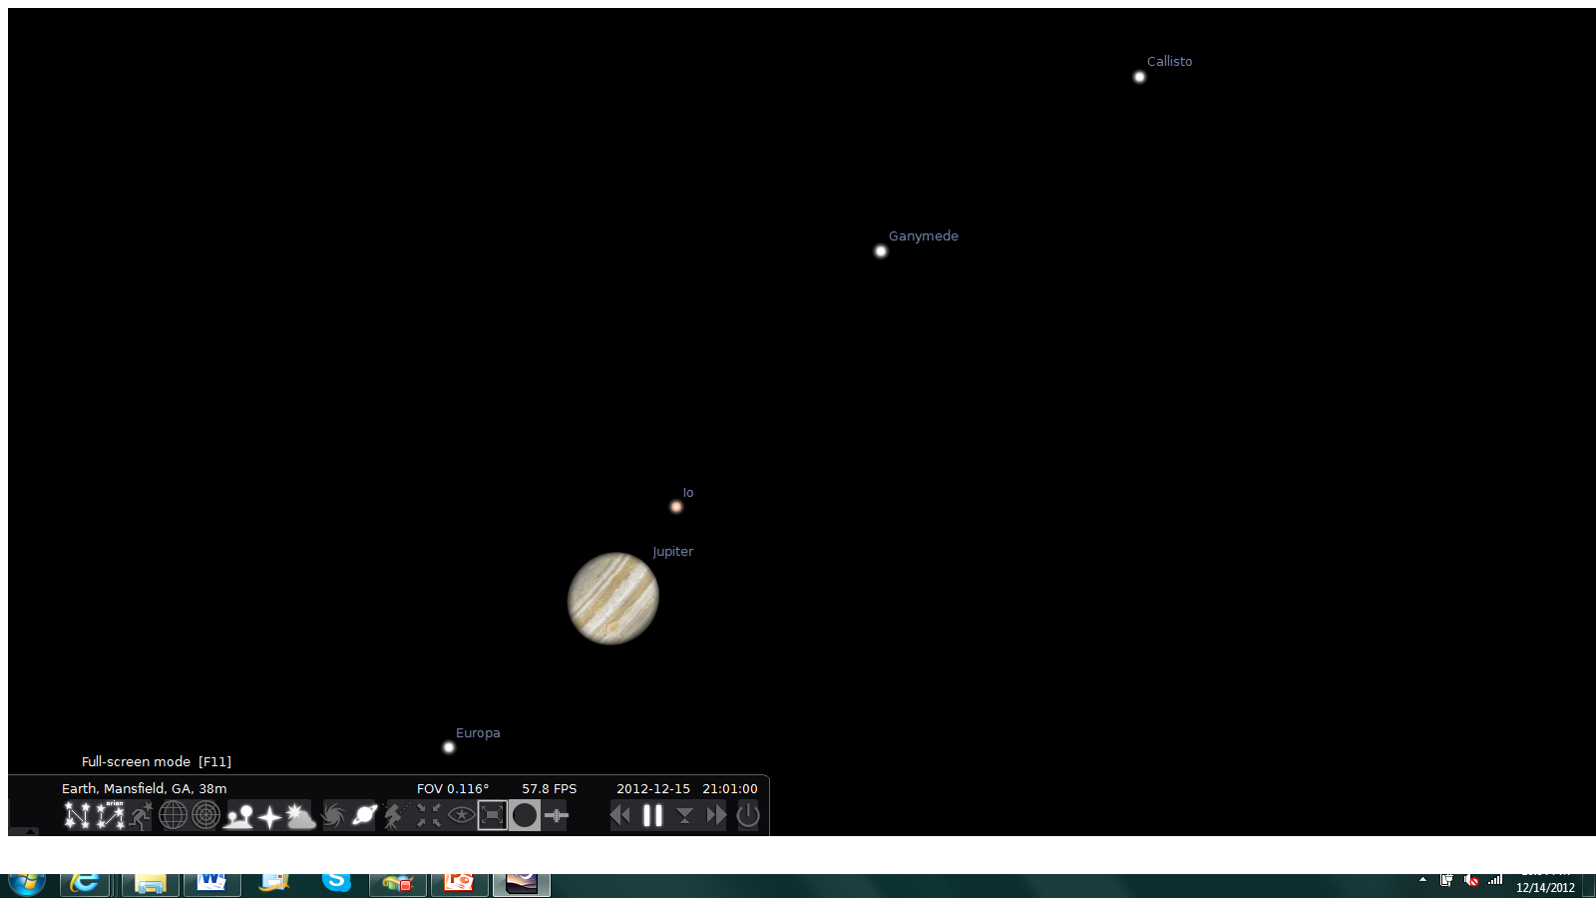
Jupiter Dominates
Jupiter is at its peak and is visible all night

Slide 10
Target List
Object | Type | Mag | Constellation
M45 (Pleiades) | Open Cluster | 1.5 | Taurus
NGC 2237/38/39 | Bright Nebula | 5.5 | Monoceros
NGC 2264 (Christmas Tree Cluster) | Open Cluster | 4.1 | Monoceros
M65 | Spiral Galaxy | 9.3 | Leo
M66 | Spiral Galaxy | 8.9 | Leo
NGC 3628 | Spiral Galaxy | 9.5 | Leo
M39 | Open Cluster | 4.6 | Cygnus
M2 | Globular Cluster | 6.5 | Aquarius
NGC 1365 | Spiral Galaxy | 9.6 | Fornax

Slide 11
Gee Whiz Question of the Month
How old is the oldest planet that has been discovered up to this point?

Slide 12
Gee Whiz Question of the Month
12.7 Billion Years Old
“The Genesis Planet”

Slide 13
CE Observing Challenge
Footprint Nebula
Magnitude 11
In Cygnus
Near Deneb
ENJOY!!!

Slide 14
Useful Websites
http://www.almanac.com/astronomy/
http://astrojourney.wordpress.com
http://www.astronomy.com/

